Slide 1
Connecting audio parameters & modulation

Slide 2
Connections in the Web Audio API
An audio node can connect to several different nodes or parameters
Several nodes can connect to an audio node or parameter
An audio node can connect back to itself or one of its own parameters
An audio node cannot have several connections to the same audio node or parameter

Slide 3
FM Synthesis

Slide 4
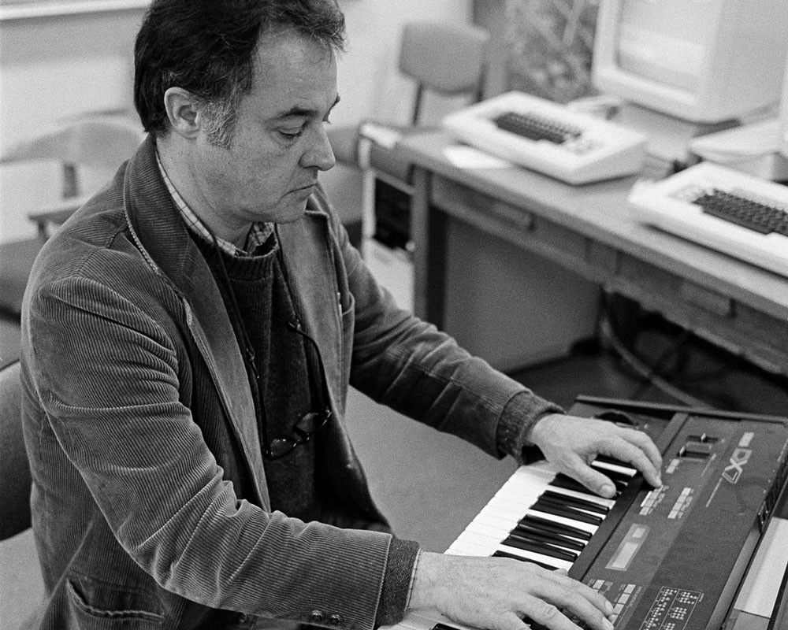
FM synthesis
Modulation - varying properties of periodic waveform, the carrier signal, with a modulating signal.
FM synthesis - Creating sound by modulating the frequency of a waveform using another waveform
Chowning, John M. "The synthesis of complex audio spectra by means of frequency modulation." Journal of the audio engineering society 21.7 (1973): 526-534.
Vary A – Amplitude modulation
Vary f – Frequency modulation
Vary φ – Phase modulation
Technically, we will do phase modulation
$$x(t)=A\sin{(}2πft+φ)$$

Slide 5
Phase modulation synthesis
Simple sine wave
x(t) – the carrier
f _{c} – carrier frequency, or frequency offset, gives fundamental frequency
Now modulate the frequency
f (t) – the modulator
f _{m} –modulation frequency
D – modulation depth
$$x(t)=\sin{(}2πf_{c}t)$$
$$f(t)=D\sin{(}2πf_{m}t) \\ →x(t)=\sin{(}2πf_{c}t+f(t)) \\ =\sin{(}2πf_{c}t+D\sin{(}2πf_{m}t))$$
Notes:
See https://www.eeeguide.com/theory-of-frequency-modulation-and-phase-modulation/
http://www.cs.cmu.edu/~music/icm-online/readings/fm-synthesis/fm_synthesis.pdf

Slide 6
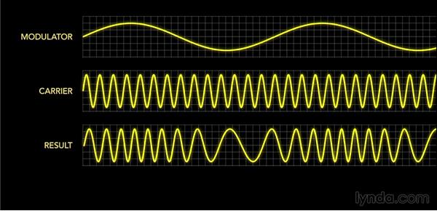
Example

